Slide 1
While and For loops
Sarah Khoja

Slide 2
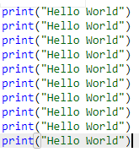
Iteration: why is it important?
It allows us to write less code, and more efficient code!
Example:
Print “hello world” 10x’s
This is unnecessary code.
You will never do anything like this in practice

Slide 3

While loops:
Continue doing what is within the loop, until I tell you to stop
Components of the loop:
Body (what to do)
Continuing condition (how many times?)
A way of reaching the stopping point (increment)
Example:
while i<10 -> continue while true
As long as i is less than 10, keep executing the body of the while loop
print(“hello world”)
body , what to do
i+=1 → a way of reaching the stopping point
If we do not increment 1, 0 will always be less than 10

Slide 4
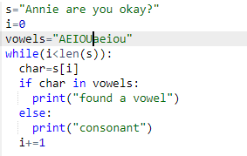
While and strings:

Slide 5
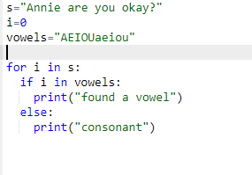
For loops to the rescue:
While loops are still too much for us to write.
For loops!
Before: while i< len(string)
Now: for i in string:
Use the for loop
Basically, a glorified while loop

